Slide 1
REACT NATIVE NOTES
BY DHRUV DHOLARIYA

Slide 2
npm start -- --reset-cache

Slide 3
Components seen till now
View
Text
inputText
ScrollView
SafesScrollView
Image
StatusBar
TouchableOpacity
Pressable

Slide 4
PROJECT-1

Slide 5
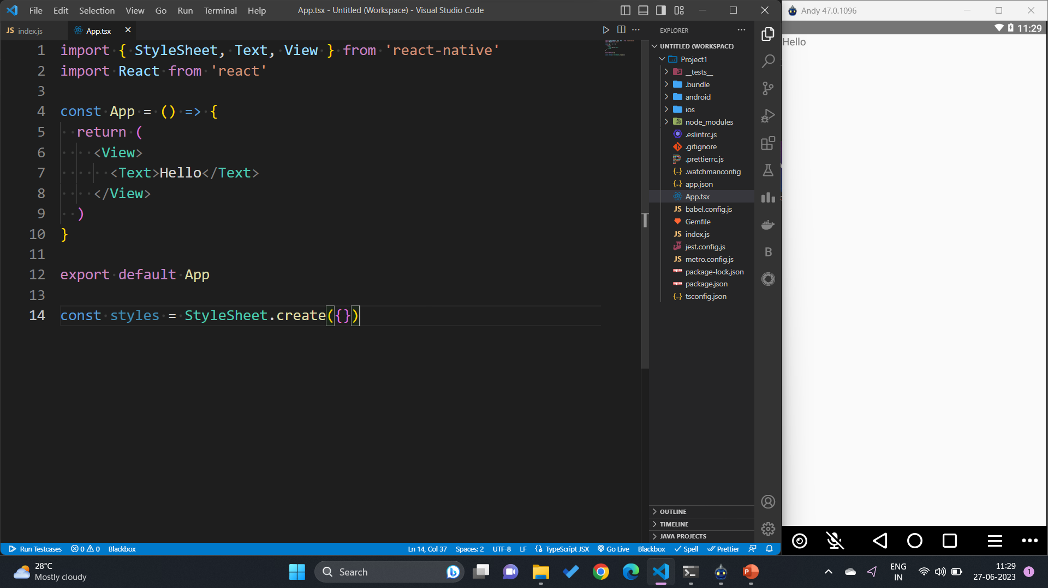
rnfes

Slide 6
Style React Native

Slide 7
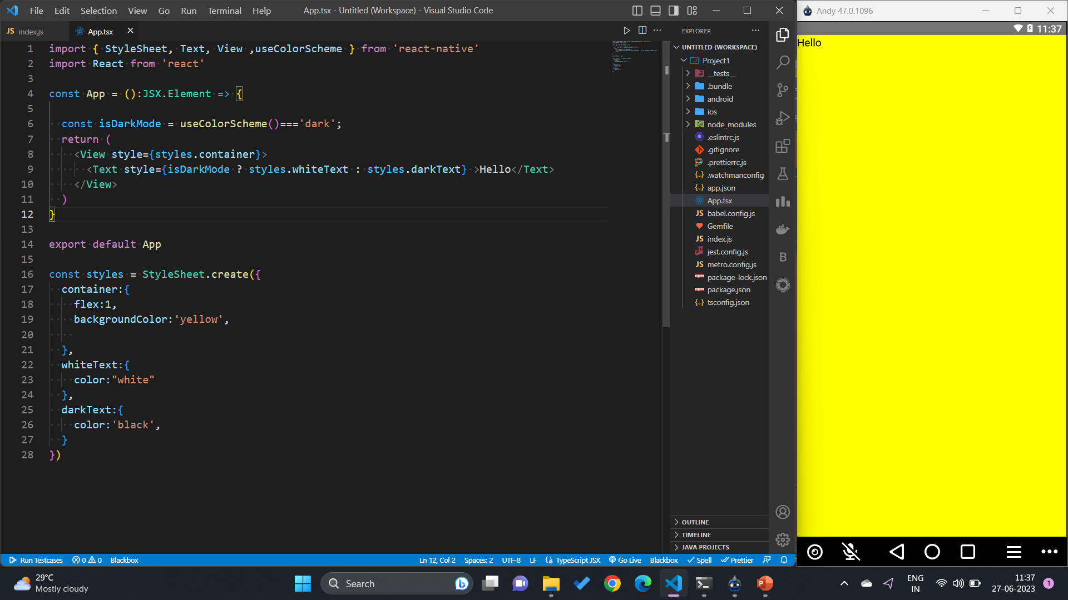

Slide 8
useColorscheme()
React hook
Appearance preference

Slide 9
PROJECT-2

Slide 10
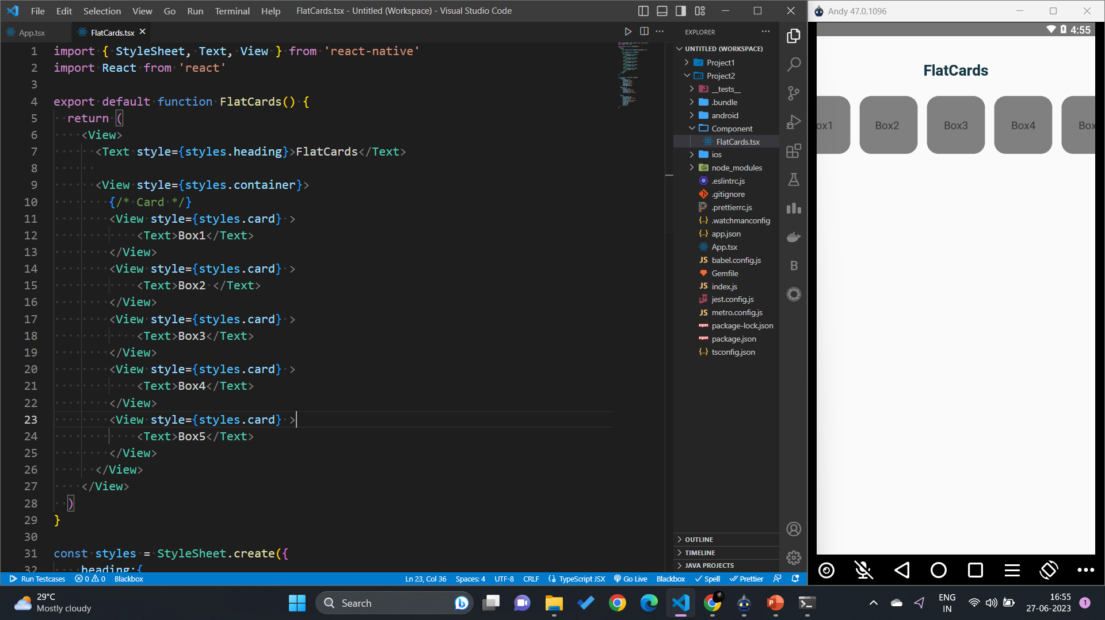

Slide 11
Scrollview

Slide 12







Slide 13
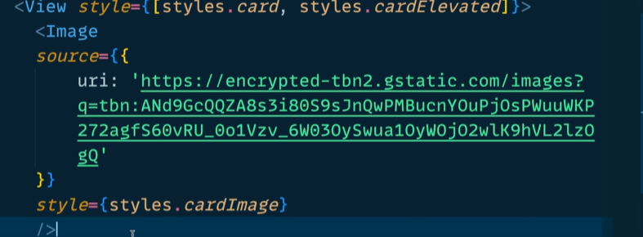
Image component

Slide 14
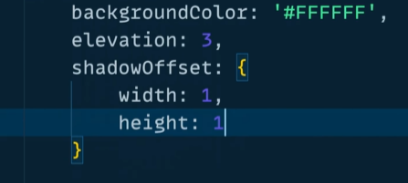
Some commonly used styles

Slide 15
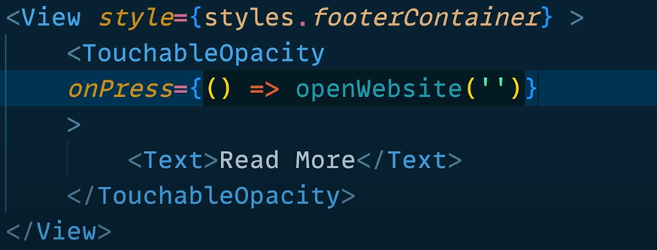




DeepLinking and Touchable Opacity

Slide 16
PROJECT-3
Password generator

Slide 17
Formik and Bubbly checkbox

Slide 18
PROJECT-4
Background changer

Slide 19
PROJECT-5
Roll the dice
and
Haptic effect

Slide 20
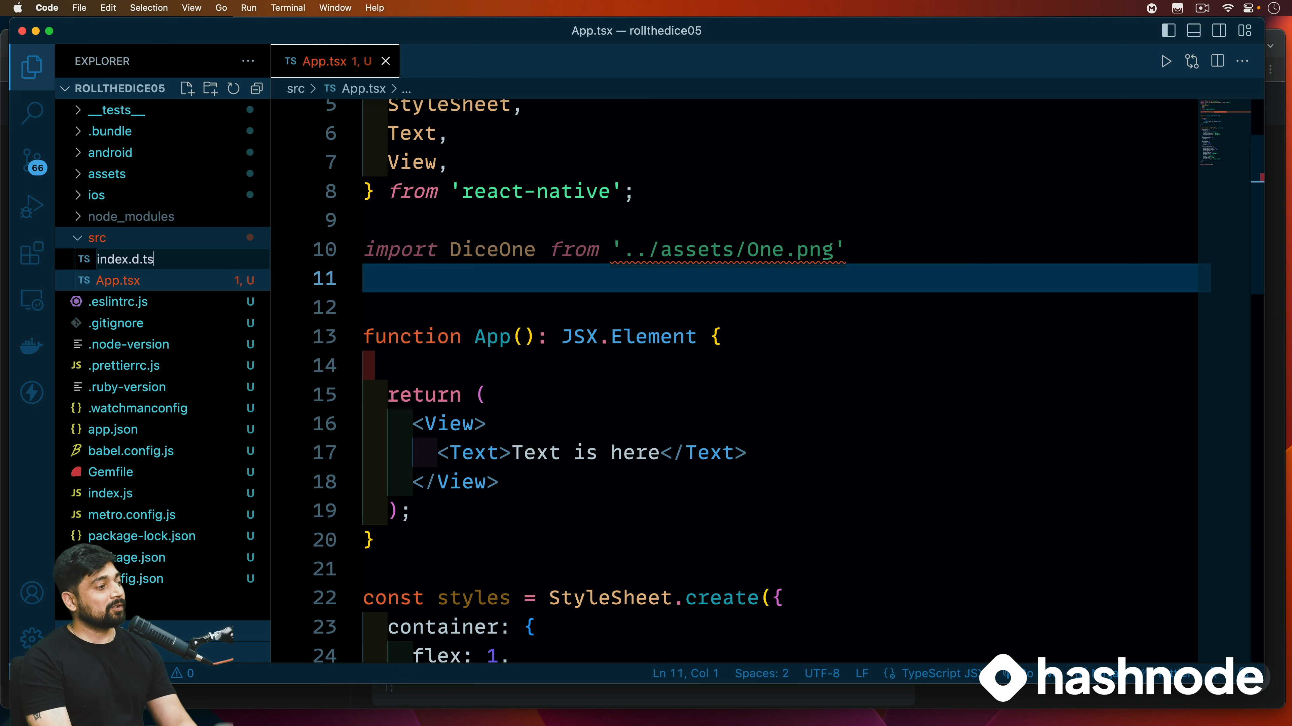


Slide 21
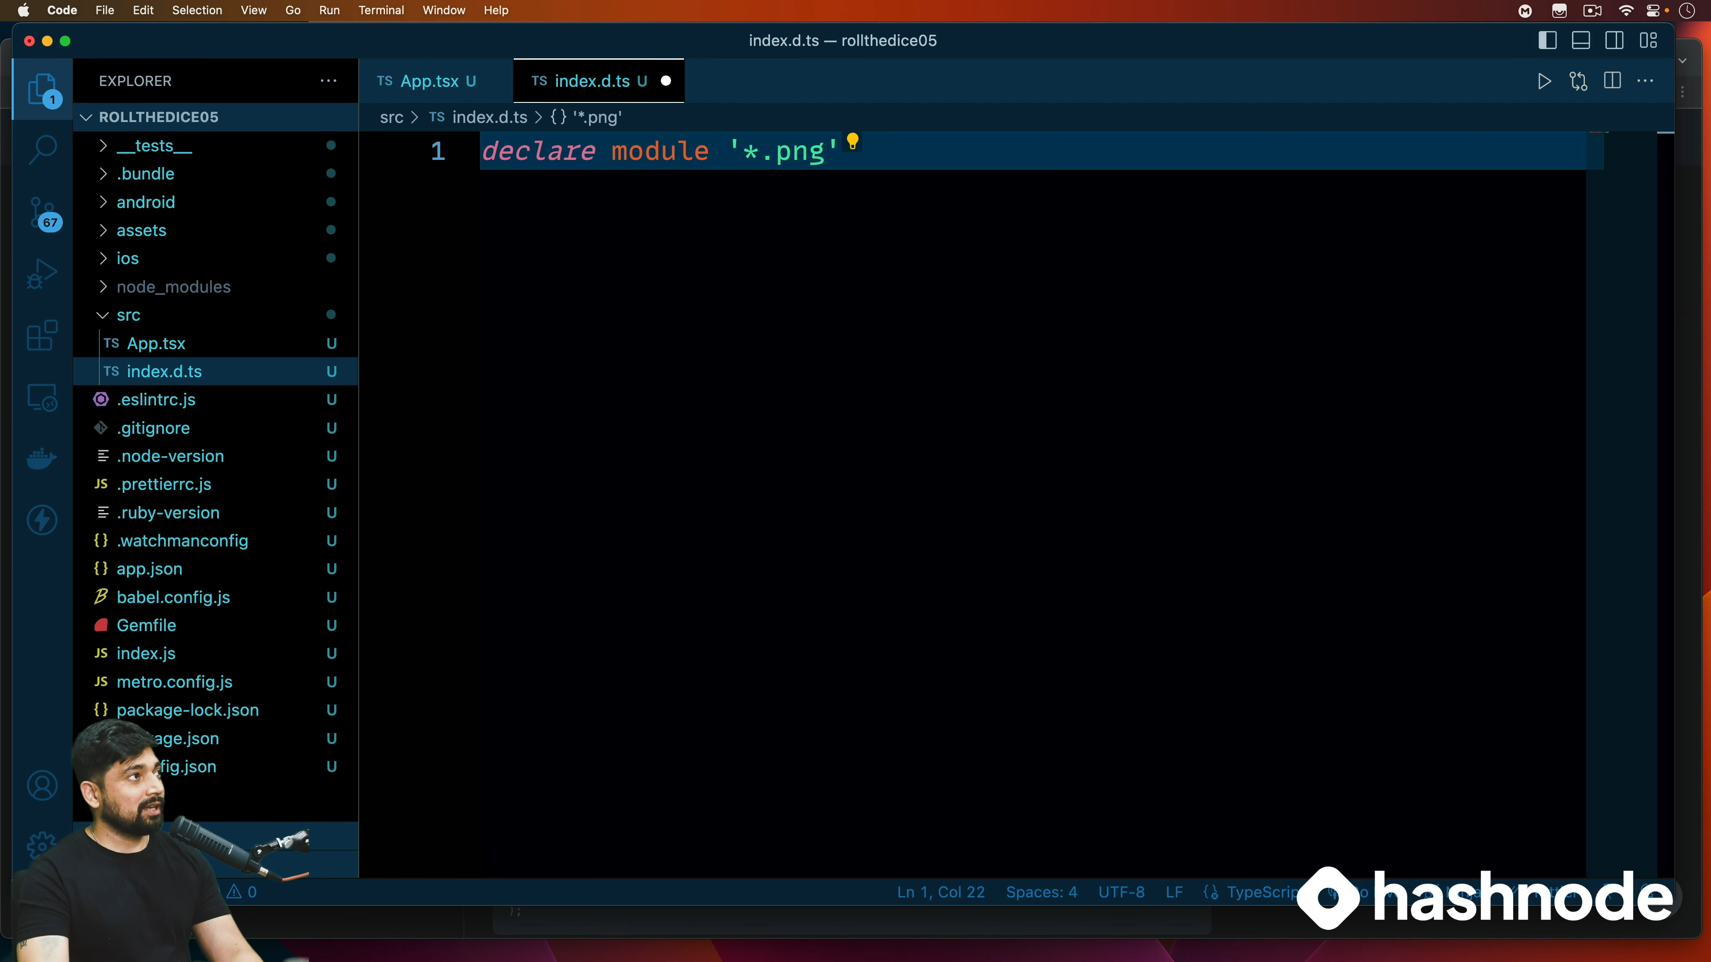


Slide 22
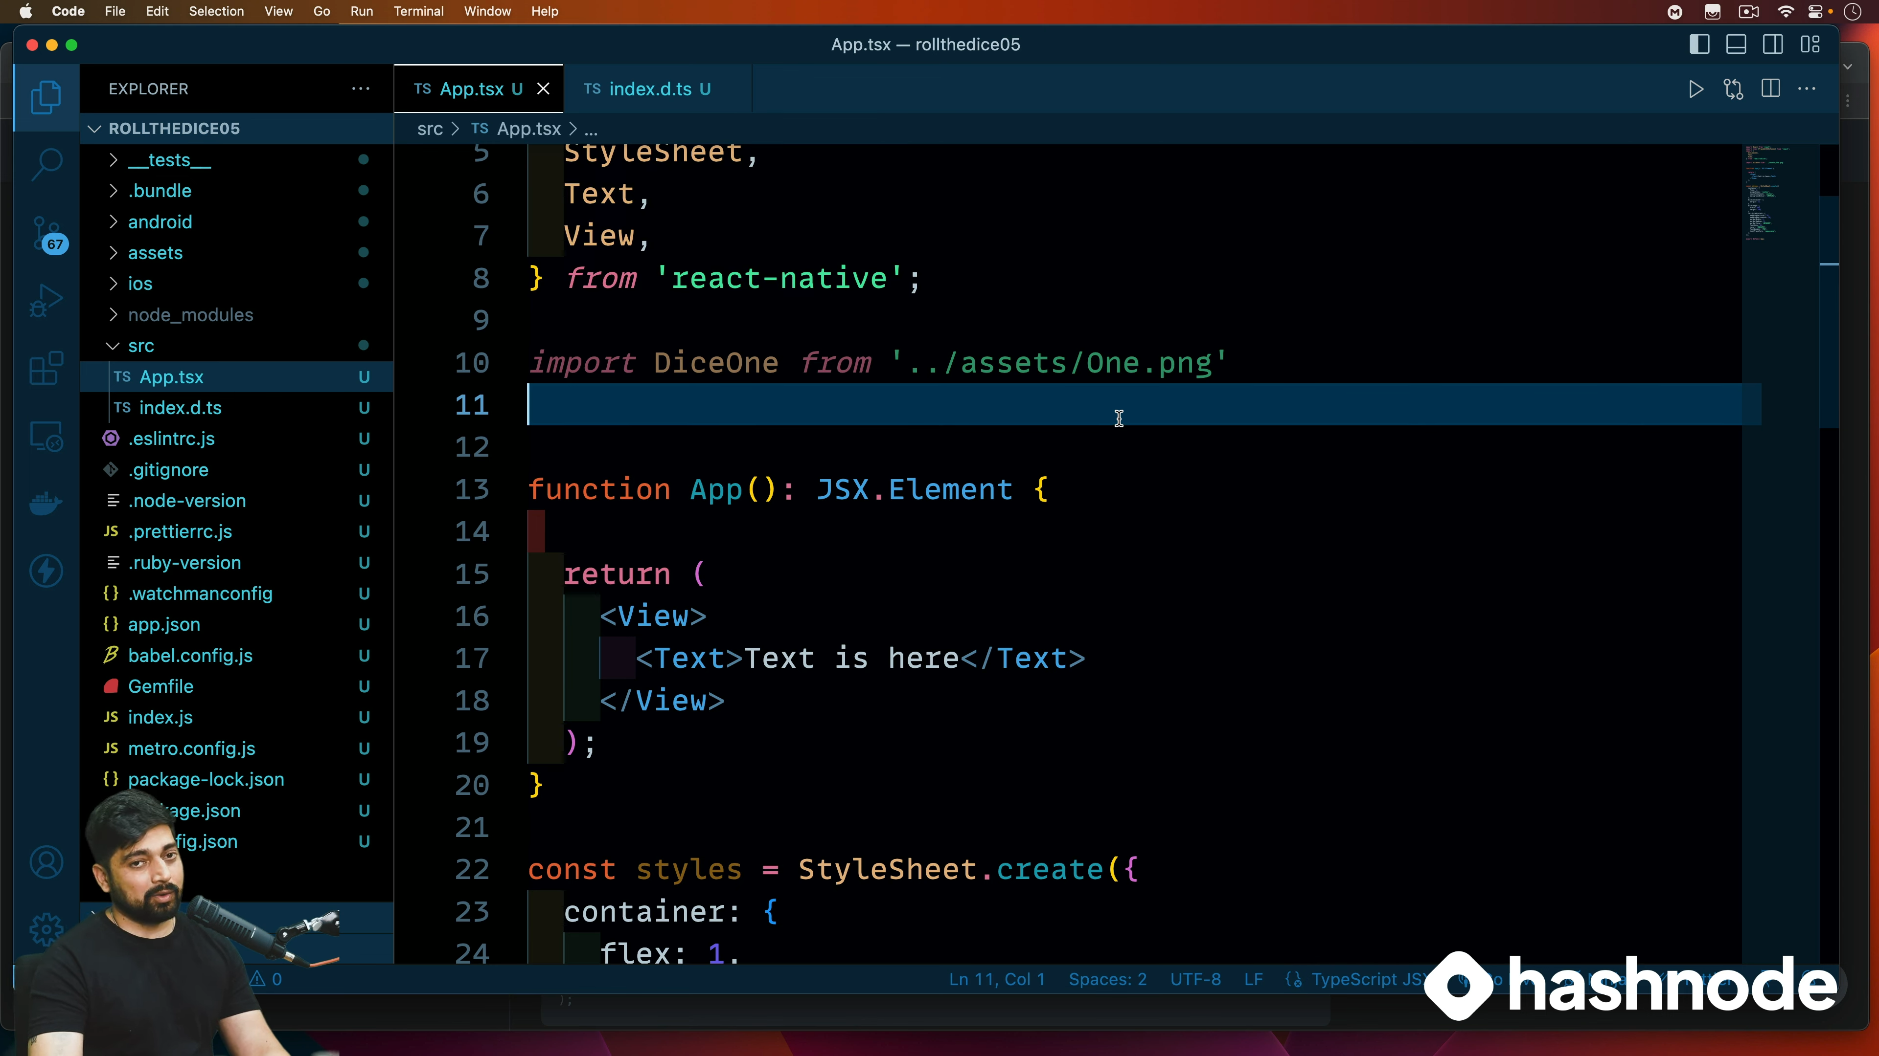

Slide 23
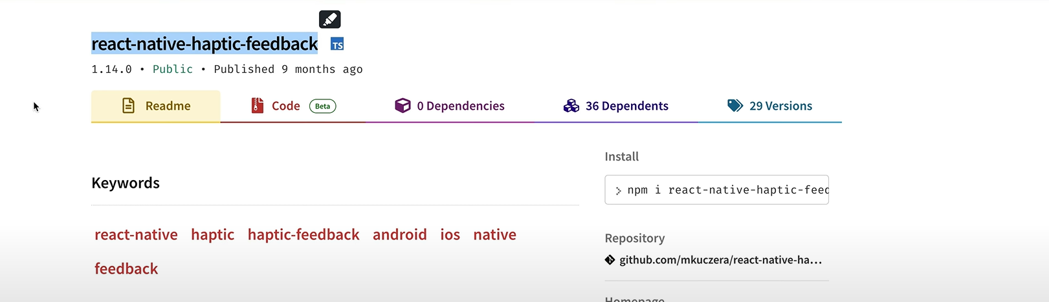
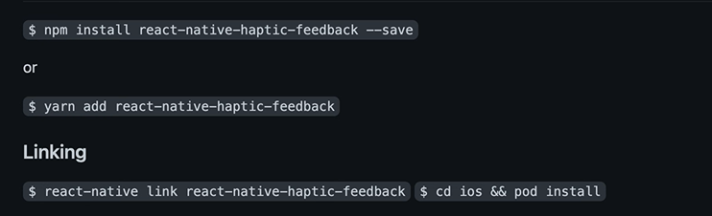

Slide 24
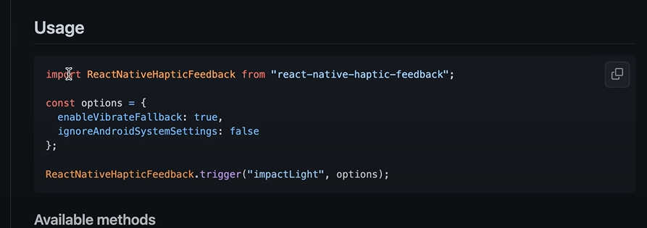

Slide 25
PROJECT-6
Currency

Slide 26
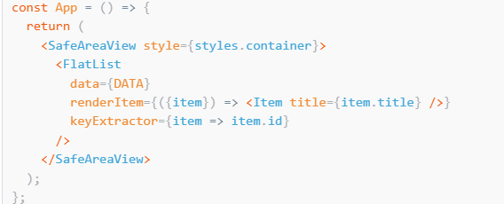
Flatlist

Slide 27
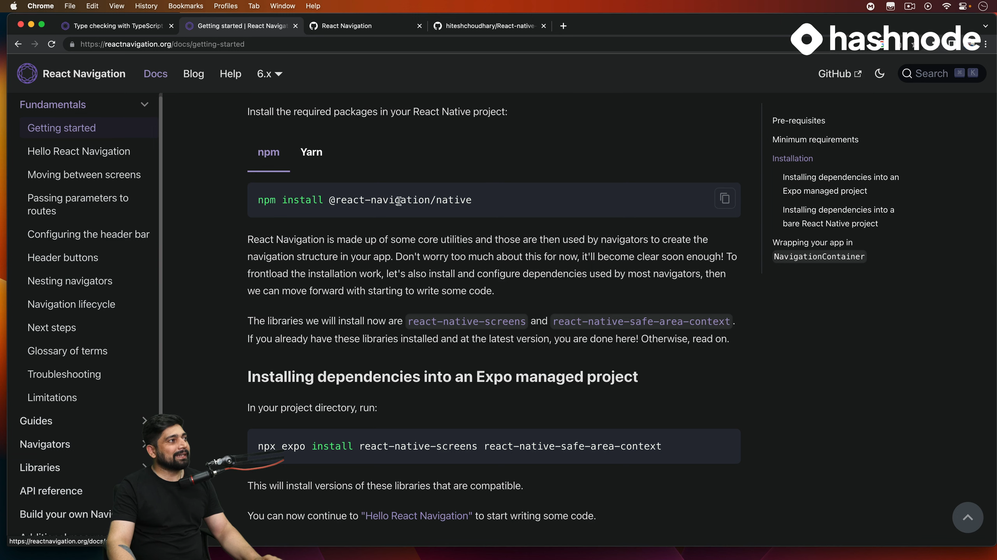
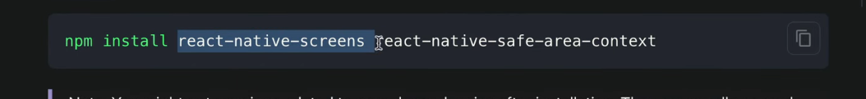
React native navigation

Slide 28
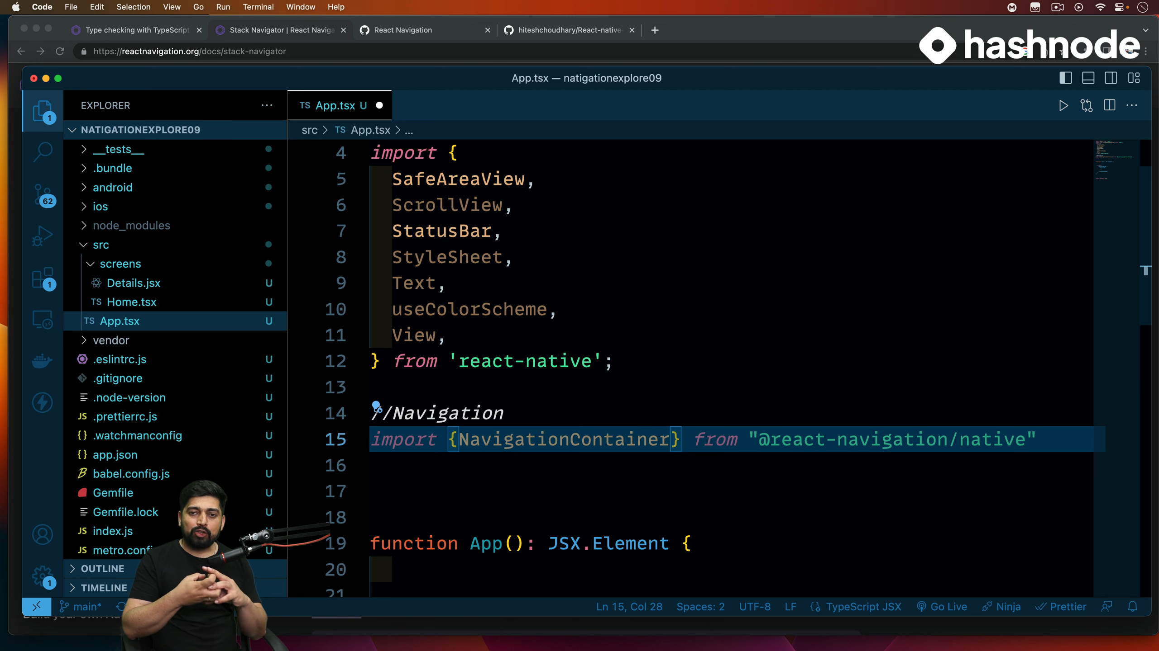
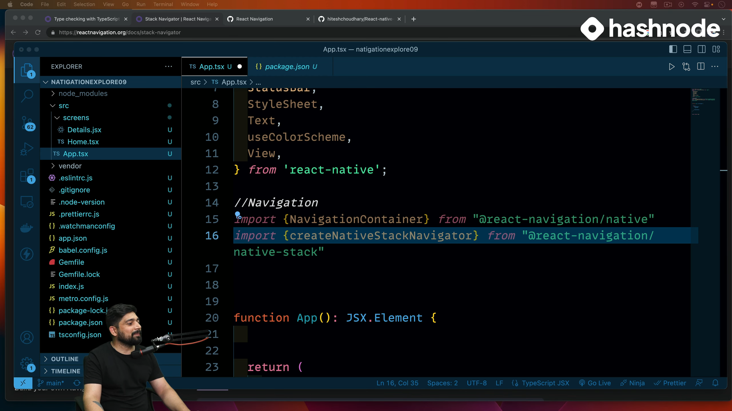



Slide 29
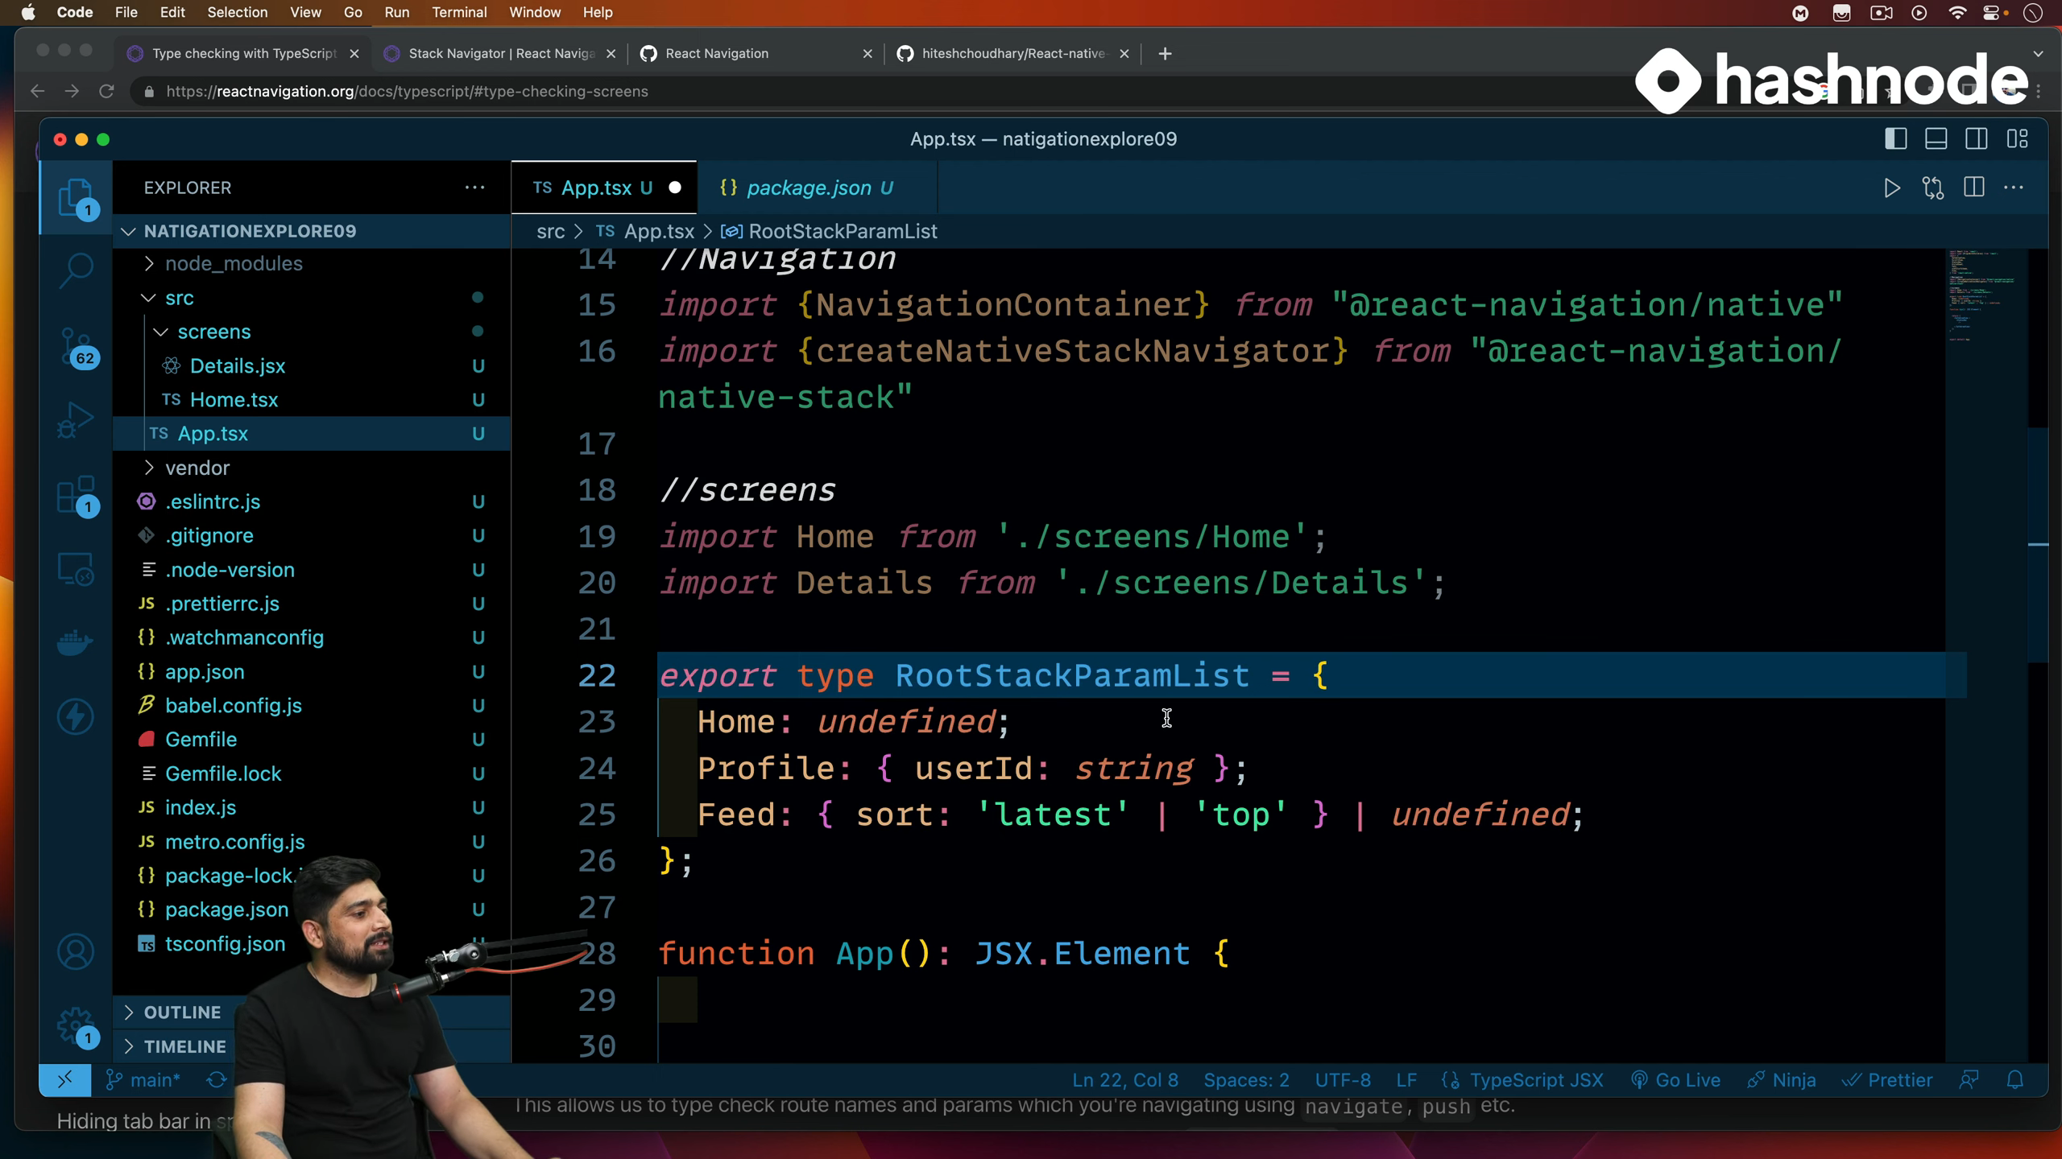
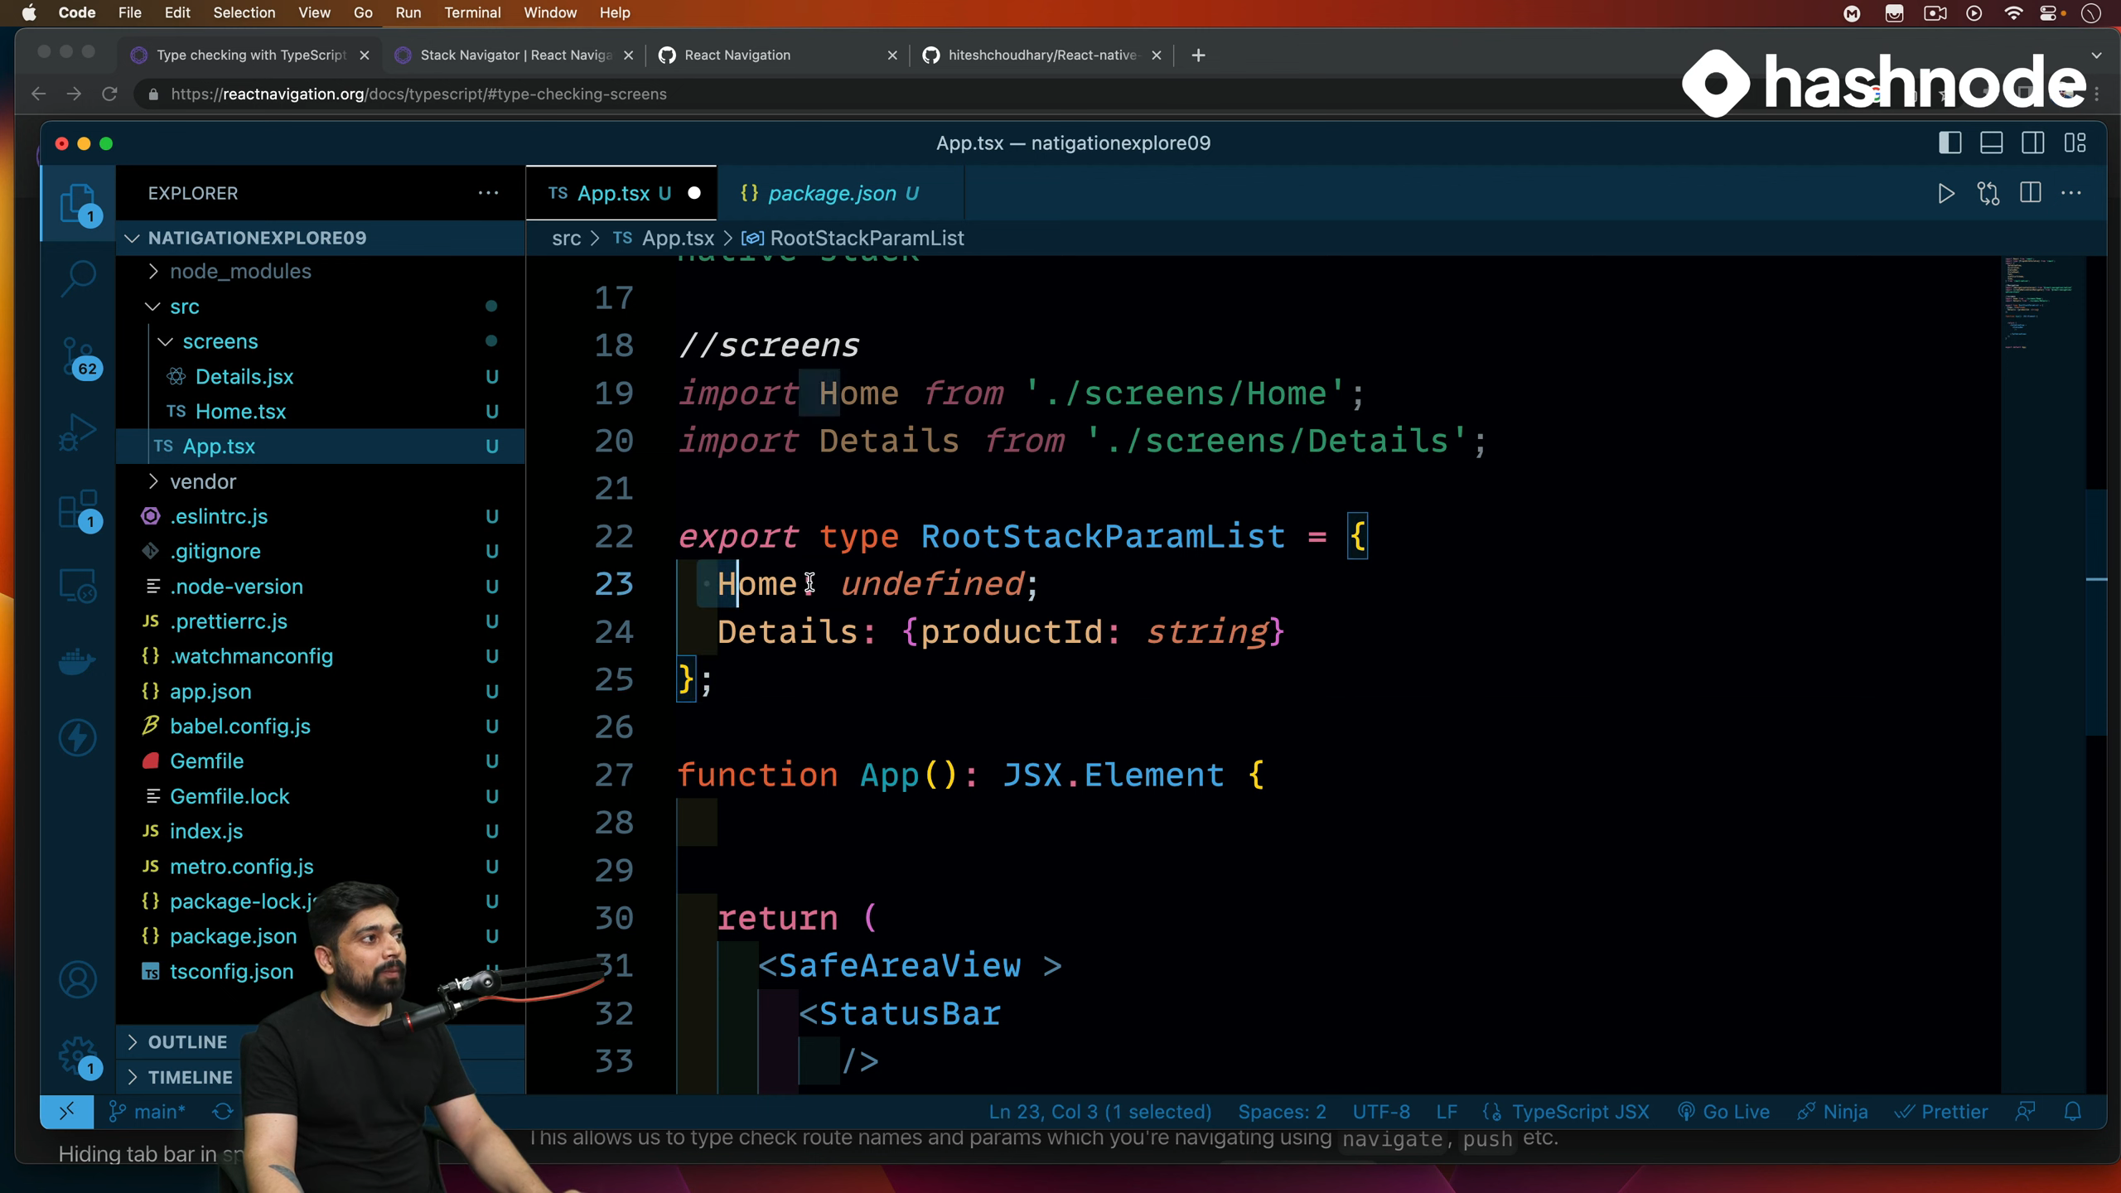



Slide 30
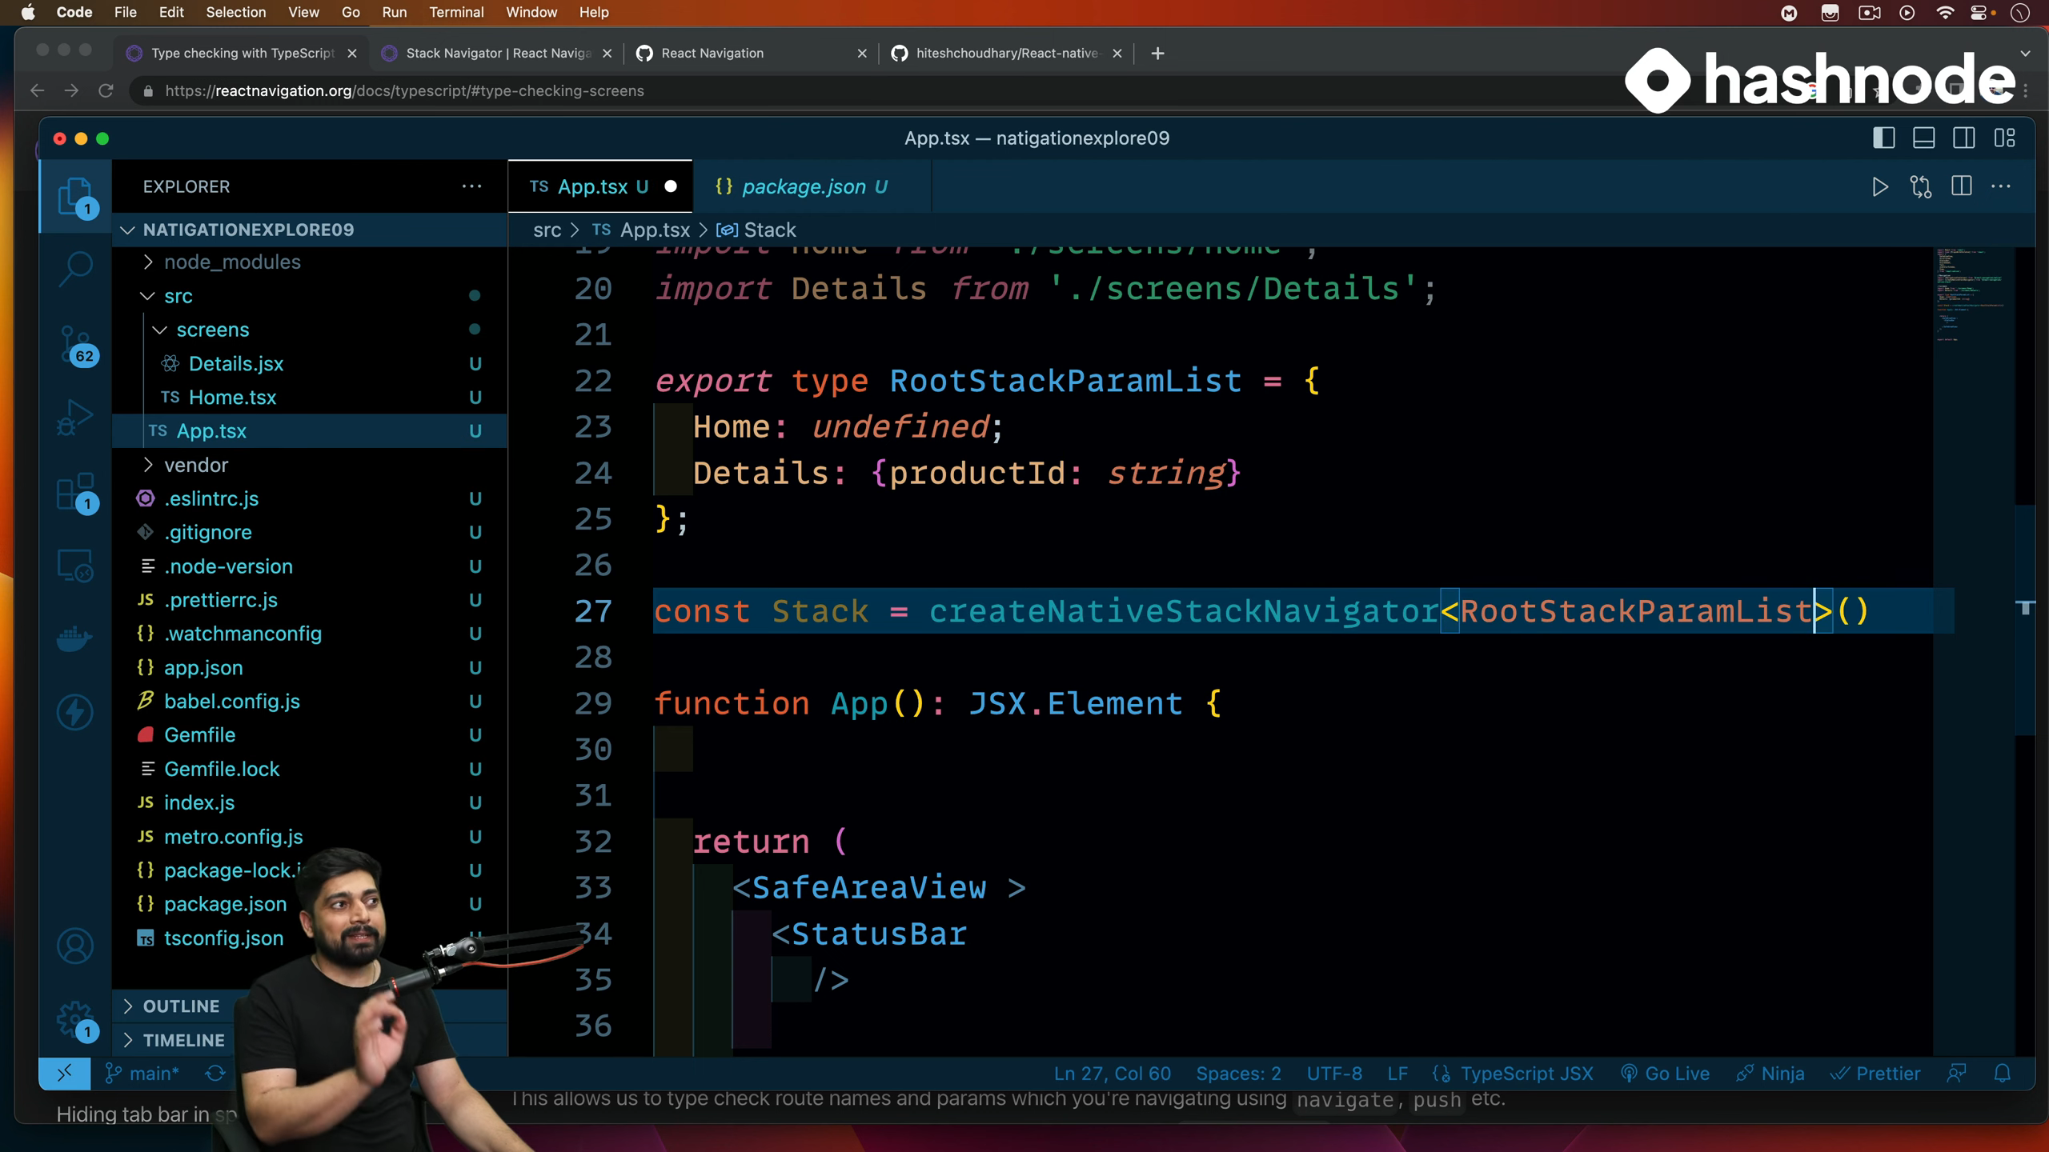


Slide 31
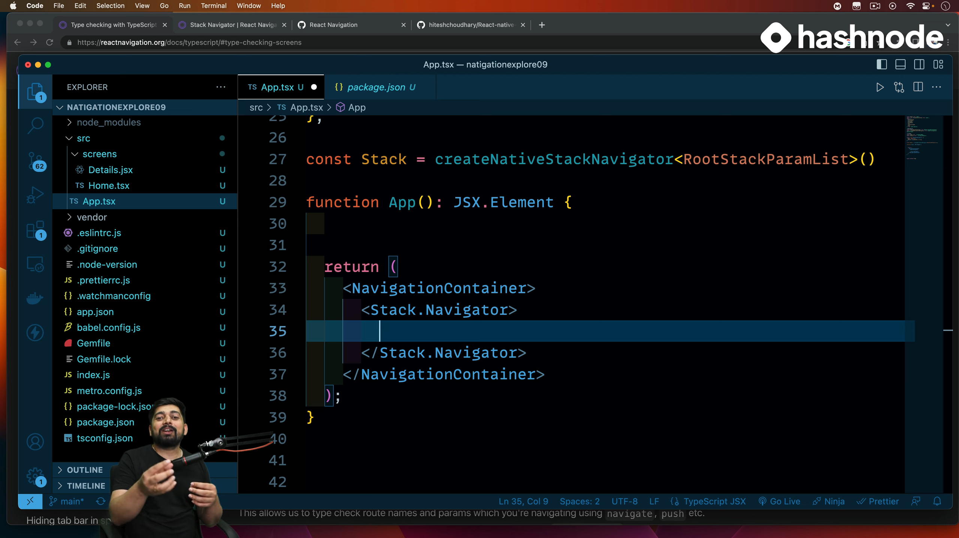


Slide 32
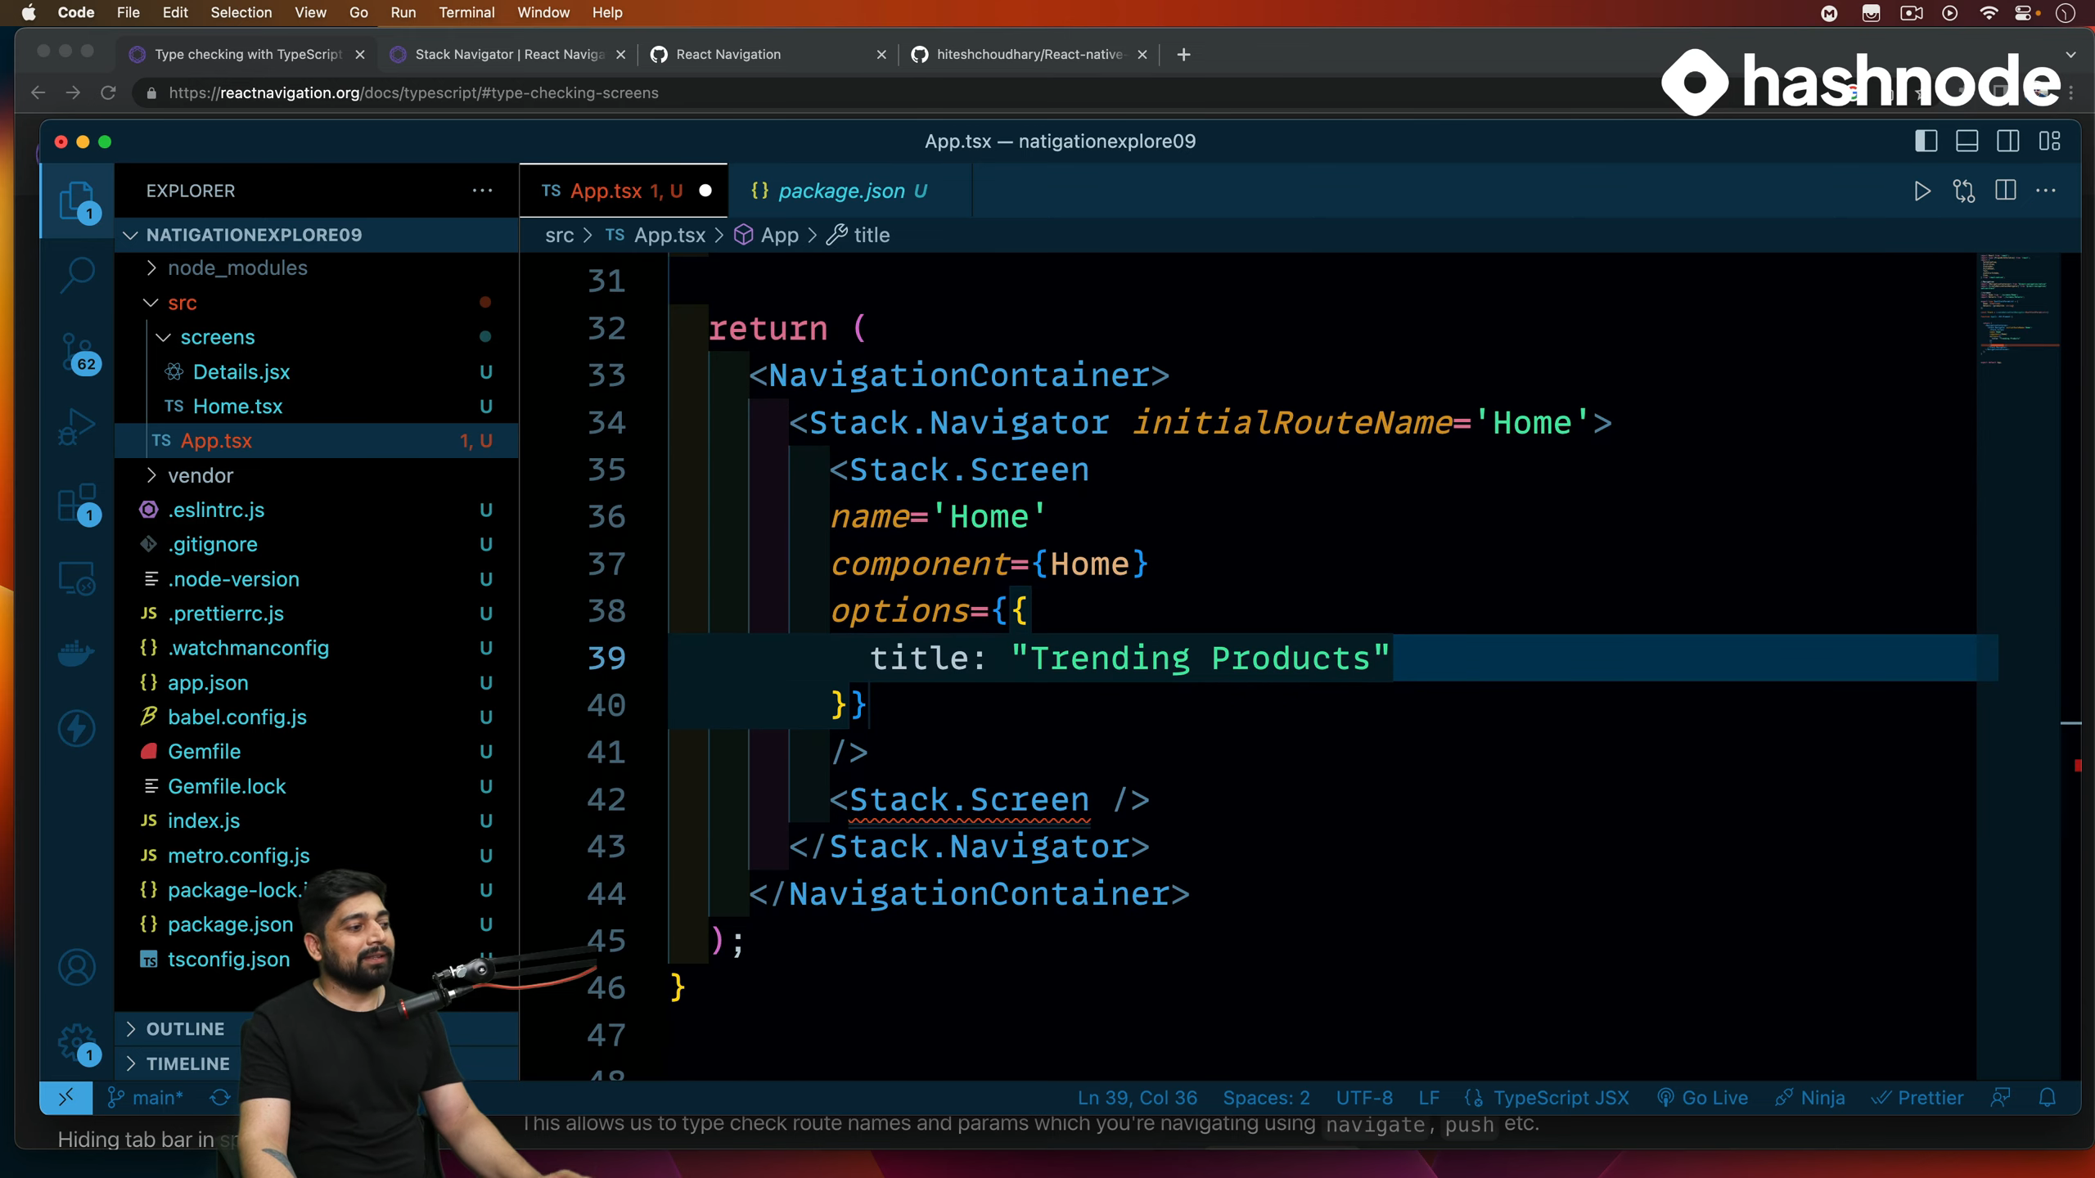





Slide 33
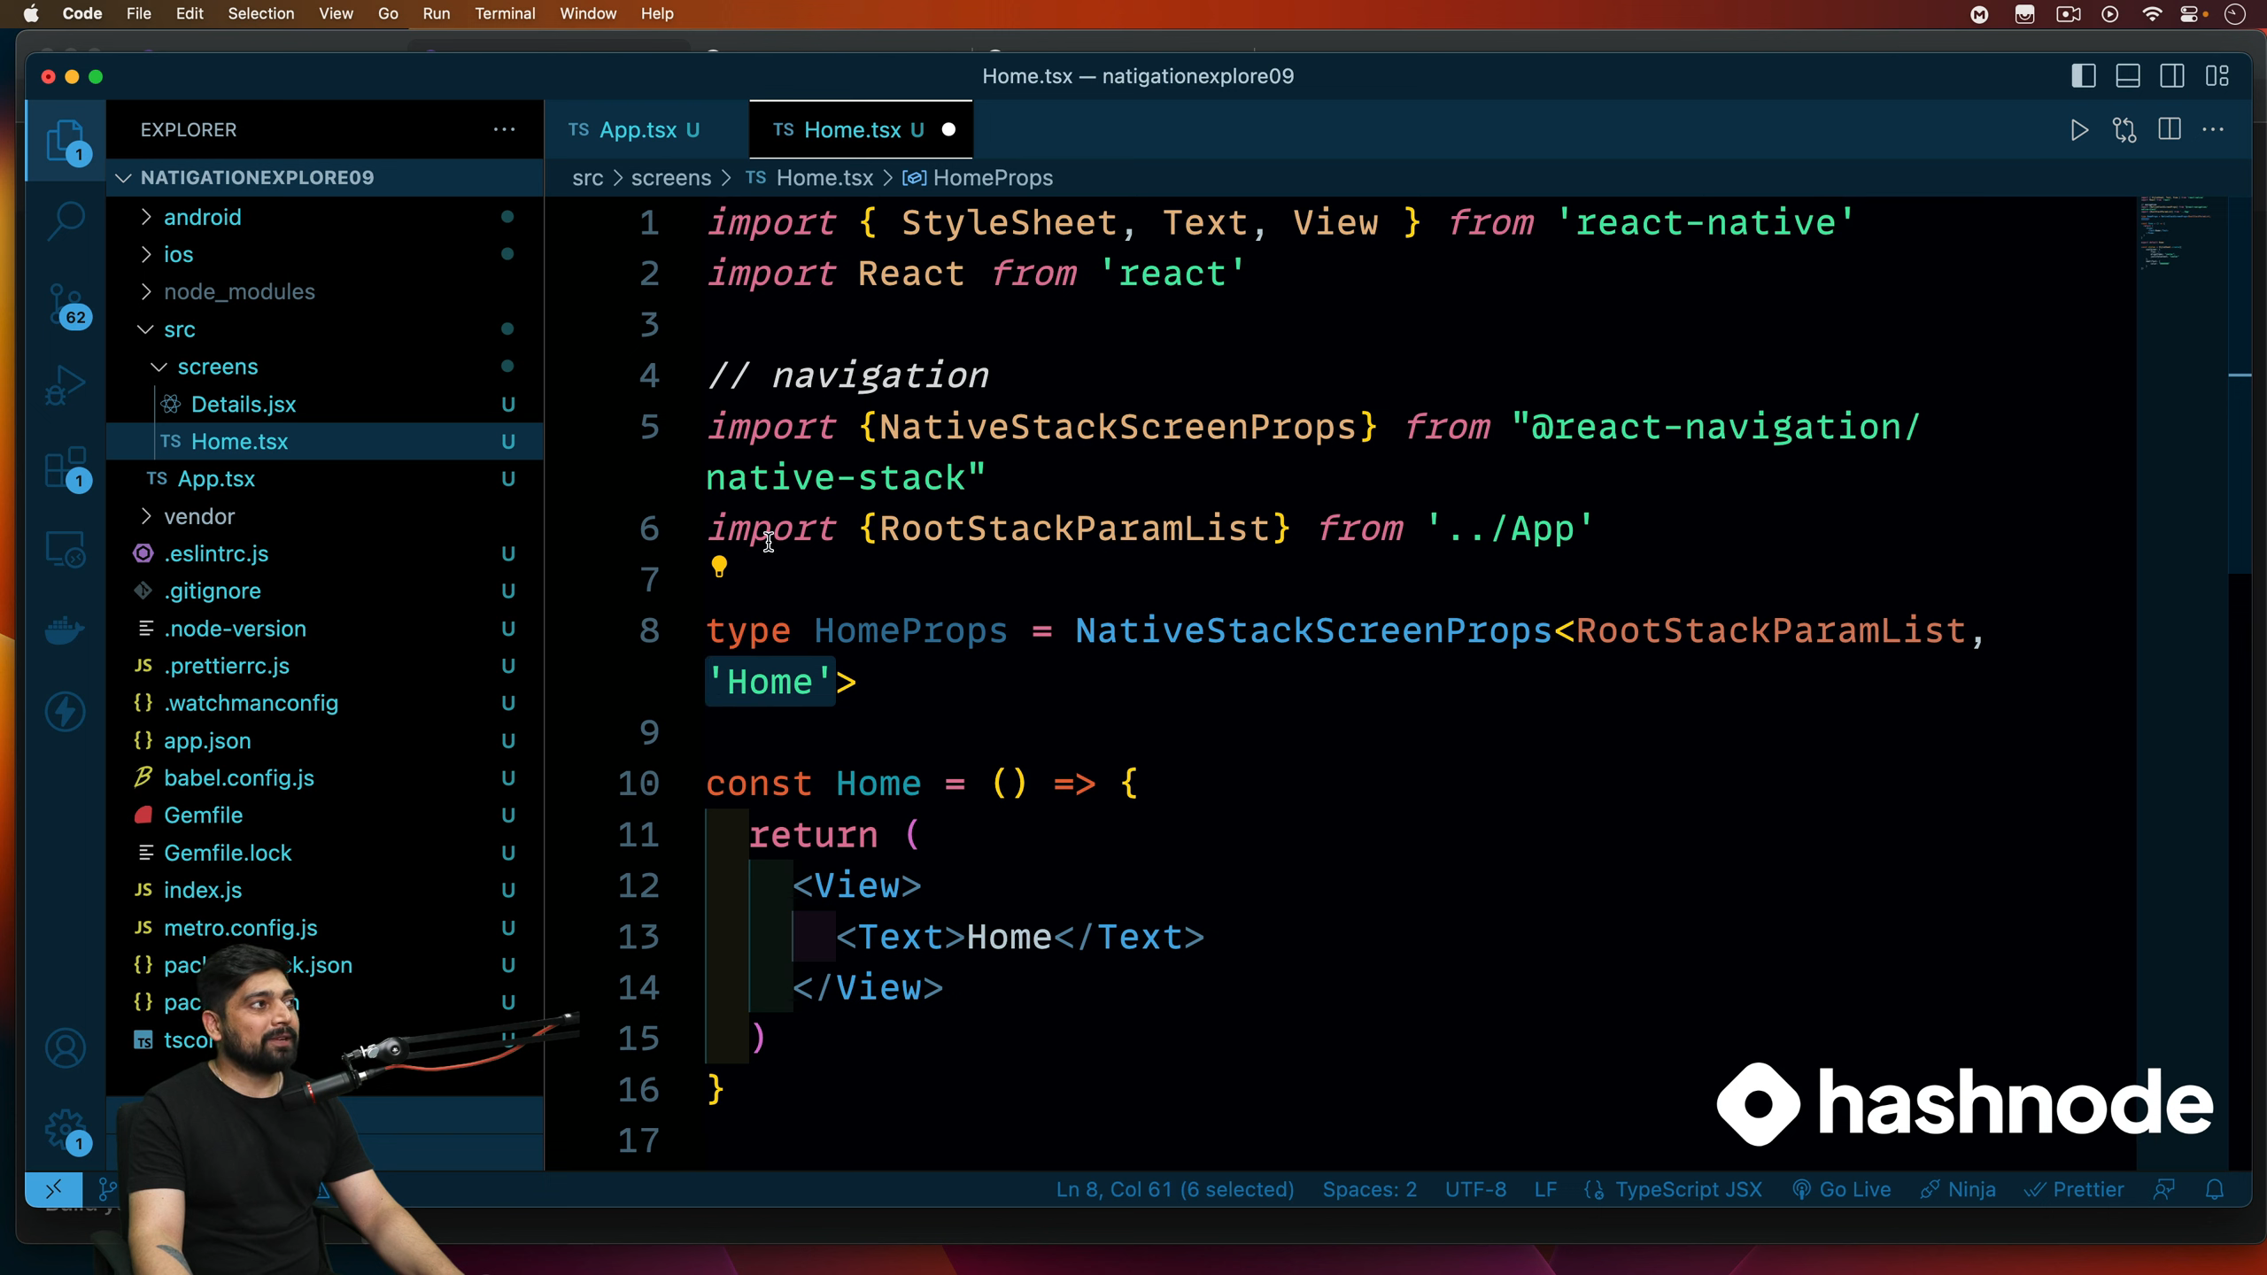


Slide 34
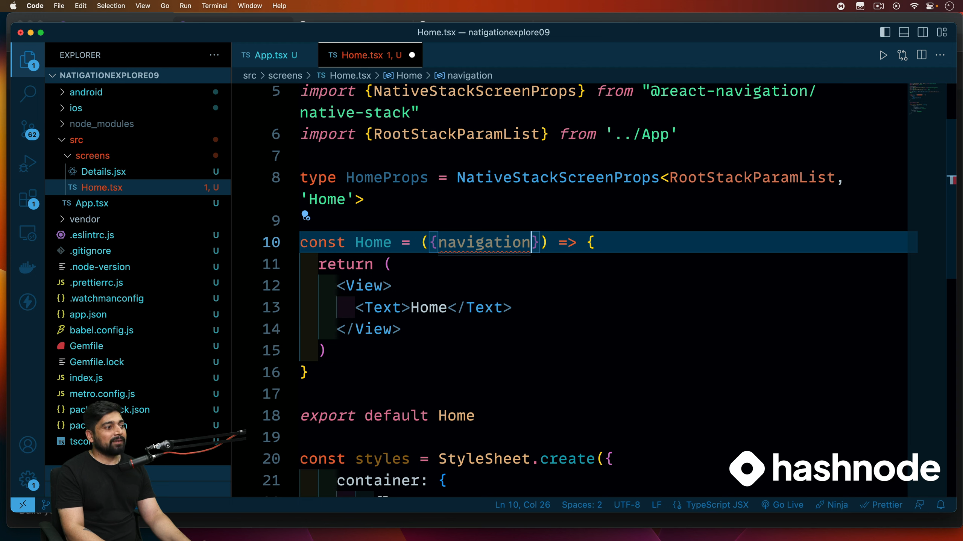
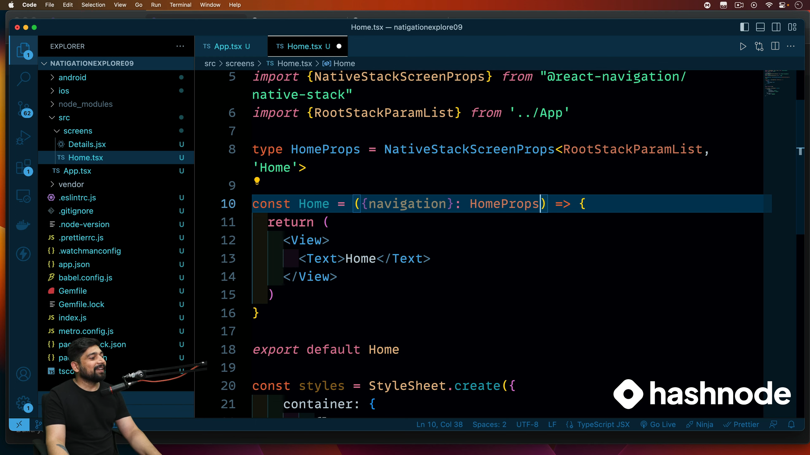




Slide 35
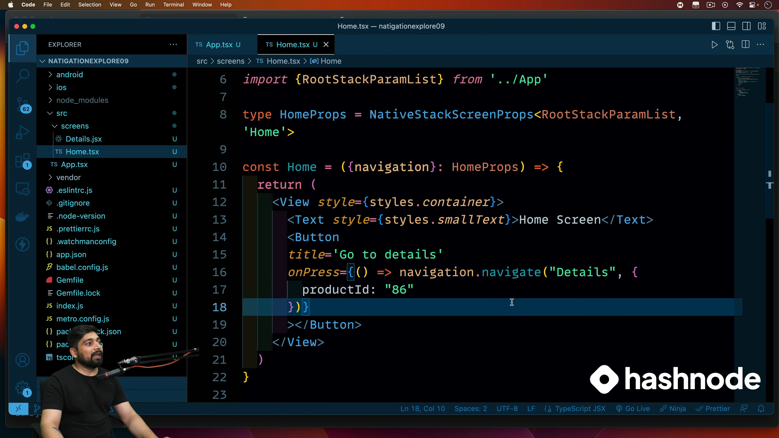


WAY-1
We have not declared Details on this page , still no error => as we have devlared it on main app,jsx

Slide 36
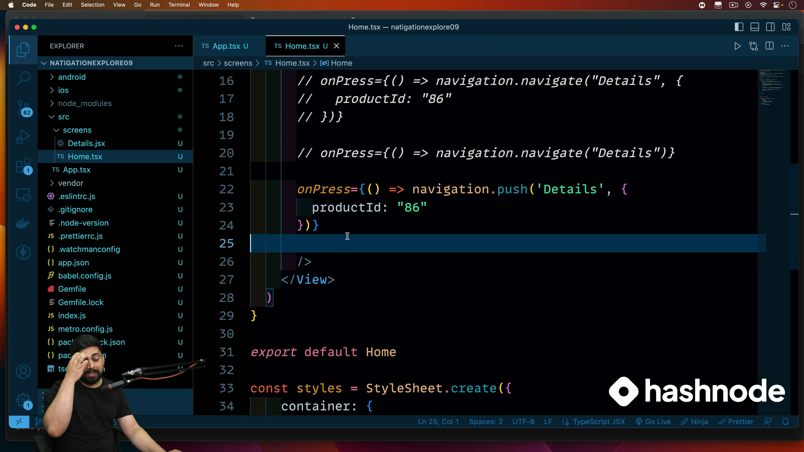







WAY-2

Slide 37
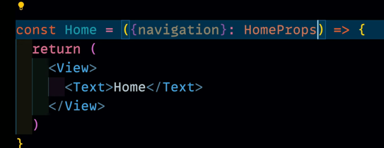
Fetching props :==
Method-1:=

Slide 38
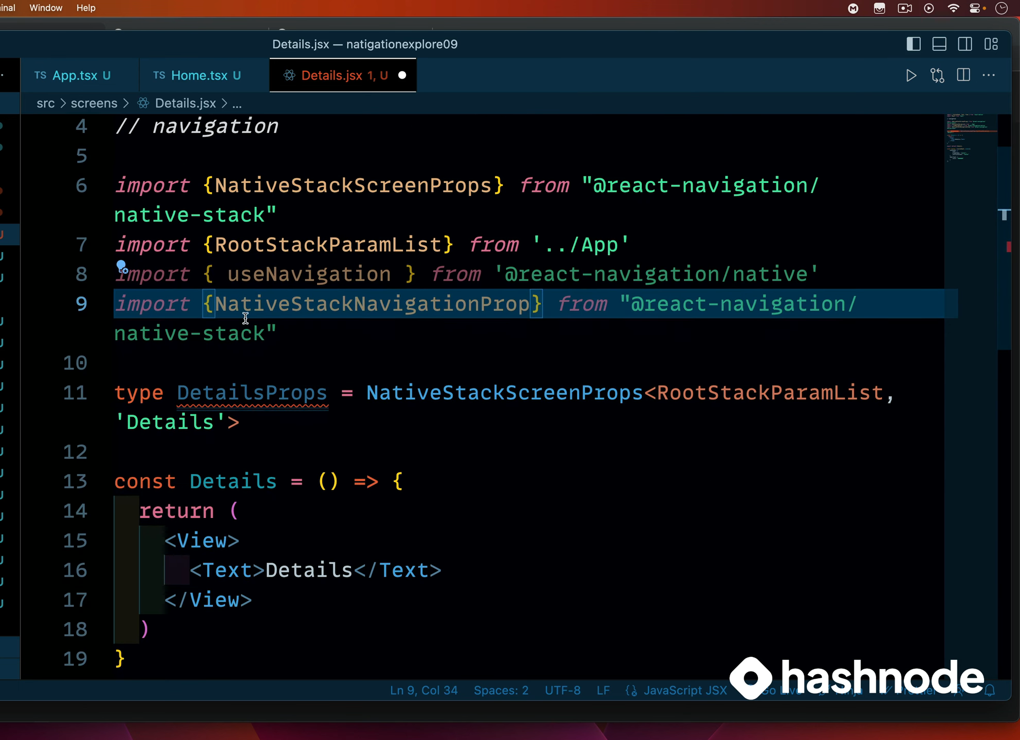

Method 2

Slide 39
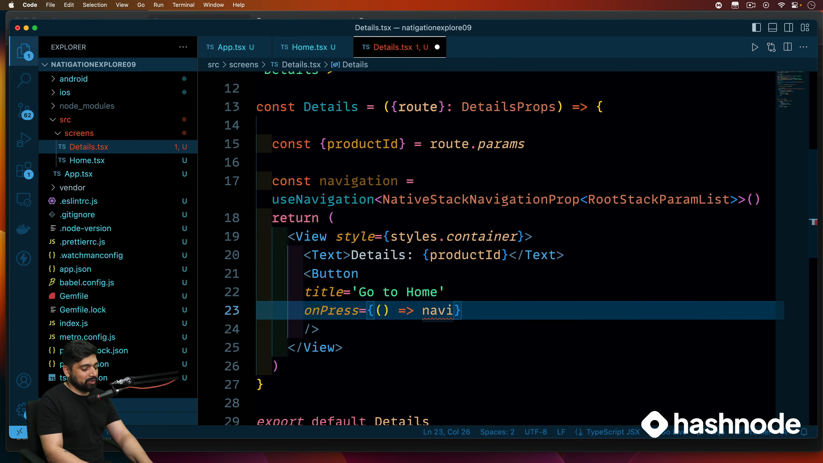




Slide 40
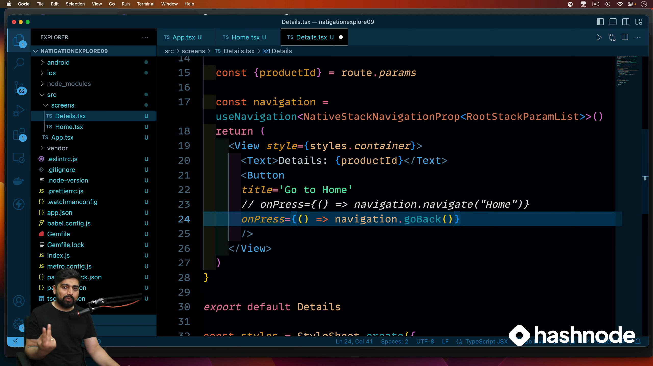


Slide 41
